Slide 1


Nature-inspired DMU Selection and Evaluation in Data Envelopment Analysis
Wuhan University of Technology – Online Conference
Seyed Muhammad Hossein Mousavi
Tehran, Iran
1
Nature-inspired DMU Selection and Evaluation in Data Envelopment Analysis

Slide 2
Introduction:
In order to have best efficient frontier, it is needed to have closer efficiency value for most of Decision Management Units (DMU) in Data Envelopment Analysis (DEA).
So, selecting best DMU’s for businesses in management before running it has high of importance.
Also, having best DMU’s pushes the business to the ideal point in the data space.
Obviously, the closer features or DMU’s to ideal point, the more efficient system is.
Nature-inspired optimization algorithms gain the most optimized approaches based on natural selection.
This differentiates them from other un-intelligent mathematical selection models.
Here Biogeography-Based Optimization (BBO) algorithm is employed to select the best features or DMU’s for business benchmark datasets.
Which this is the main significance of this research.
2
Nature-inspired DMU Selection and Evaluation in Data Envelopment Analysis

Slide 3
Introduction:
The system evaluates with four common DEA methods of:
Charles Cooper and Rhodes (CCR)
Input-Oriented Banker, Chames and Cooper (IOBCC)
Output-Oriented BCC (OOBCC)
Additive efficiently
The proposed approach compares with:
Original DEA model
Mathematical Lasso regularization
And other nature-inspired methods such as GA and PSO feature selection for all four components of evaluation.
3
Nature-inspired DMU Selection and Evaluation in Data Envelopment Analysis

Slide 4
Introduction:
Returned result depict more efficient values in most cases belongs to proposed nature-inspired DEA method.
Also, in order to present more comparisons, another optimization (Firefly) fuzzy regression algorithm is used for final linear regression part.
FA regression represent more correlation coefficient compare to traditional regression methods.
Average value of 0.914 is returned for all ranks and all datasets and for all DEA methods after the proposed feature selection method.
Additionally, average correlation coefficient of 0.945 and MSE of 0.132 are returned by fuzzy firefly regression method for all datasets and ranks.
4
Nature-inspired DMU Selection and Evaluation in Data Envelopment Analysis

Slide 5
Introduction:
Businesses and companies are looking for best ways to increase their facilities productivity and efficiency in Data Envelopment Analysis (DEA) by various of factors.
In management these factors call Decision Management Units or in short DMU’s.
Considering the efficiency of hospitals (DMU’s):
Number of Doctors (nD),
Number of Nurses (nN)
Number of Patients (nP)
As input features and Treatment per day as output, Total Efficiency could be calculated.
For instance, nD=10, nN=20 and nP=50 is more efficient than nD=15, nN=27 and nP= 25, as with less resources more patients are cured.
5
Nature-inspired DMU Selection and Evaluation in Data Envelopment Analysis

Slide 6
Introduction:
So, selecting these DMU’s wisely are so crucial to have the most efficient business experience.
To do so, number of techniques and algorithms are proposed by different researchers during years.
Most of them used old traditional feature selection methods and some of them used these algorithms for other purposes of DEA which are the limitations.
Here, DMU’s or feature are selecting based on nature intelligence which is called nature-inspired or bio-inspired algorithm which is the main objective.
We used Biogeography-Based Optimization (BBO) algorithm for feature selection.
BBO is faster than other optimization algorithms and returns more optimized results in less iterations.
This lead to select best DMU’s (with higher value closer to 1) for the business.
6
Nature-inspired DMU Selection and Evaluation in Data Envelopment Analysis

Slide 7
Introduction:
Basically, BBO feature selection, removes any weak DMU’s which may result low value efficiency and DEA.
Furthermore, by increasing number of samples to for example 100 and number of DMU’s or features to for example 10, selecting best DMU’s is a laborious task.
So, when dealing with big datasets, removing some of the weak samples is so rational.
The main goal is to select those DMU’s which are closer to efficient frontier.
7
Nature-inspired DMU Selection and Evaluation in Data Envelopment Analysis

Slide 8
Literature Review:
Feature selection or dimensionality reduction is a vital task in data mining and big data.
It is done by decreasing number of feature and selecting best ones.
By doing that not only processing speed increases but also, outliers which are less desired, eliminate from the main process.
Principle Component Analysis (PCA) is one of the most effective but, traditional feature selection in data mining.
Another more advanced feature selection algorithm is called Lasso regularization which, is more time consuming but ends up with more effective features.
8
Nature-inspired DMU Selection and Evaluation in Data Envelopment Analysis

Slide 9
Literature Review:
Another interesting feature selection based on DEA research is belonged to Zhang, Yishi, et al.
In which They did something in revers of this research’s purpose.
Actually, they used DEA of each DMU as their final feature selection factor,
In which those DMU’s with higher DEA values got selected.
Among nature inspired algorithms, PSO feature selection and Genetic feature selection are two best.
Nature inspired techniques always return more impactful features but gain more complexity.
Proposed BBO feature selection for DMU would be compared with all these four mentioned algorithms in validation section.
9
Nature-inspired DMU Selection and Evaluation in Data Envelopment Analysis

Slide 10
Proposed Method and Evaluations:
Clearly, DMU’s in DEA, defines system’s performance and in a small business, DMU’s values could be determine easily.
However, in a big business or in dealing with real big data, things are different.
Any mathematical implementation of nature could handle certain number of mathematical problems.
One of this nature inspire algorithms is BBO algorithm, which we intend to used it for features (DMU) selection in DEA for the first time.
Based on multiple experiment on different algorithm, BBO algorithm is selected, as it returned more optimized result in faster runtime.
10
Nature-inspired DMU Selection and Evaluation in Data Envelopment Analysis

Slide 11
Proposed Method and Evaluations:
Here, each DMU is considered as a feature in the feature space which makes our final feature matrix for the main process.
After feature selection by BBO algorithm, Efficiency and DEA calculation begins.
And leads to non-linear fuzzy Firefly regression algorithm which is another bio-inspire algorithm.
Based on multiple experiment, nature inspired regression algorithms returned higher correlation coefficient than other traditional methods.
Firefly algorithm showed best performance among all which is considered for this part.
11
Nature-inspired DMU Selection and Evaluation in Data Envelopment Analysis

Slide 12
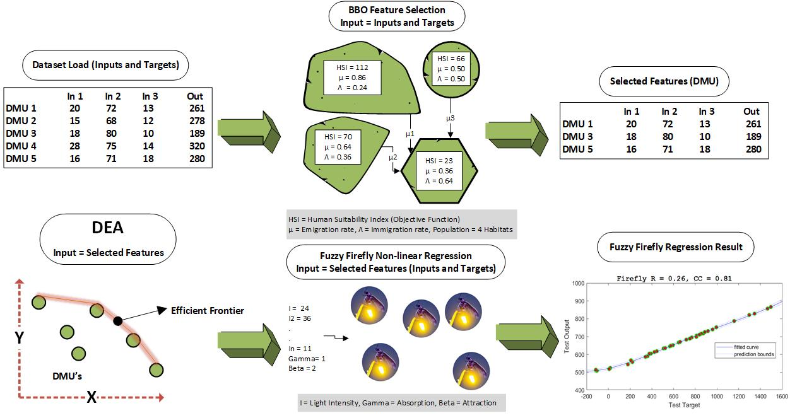
Proposed Method and Evaluations:
Workflow of Proposed Method
12
Nature-inspired DMU Selection and Evaluation in Data Envelopment Analysis

Slide 13
Proposed Method and Evaluations:
BBO Feature Selection
BBO algorithm is consisted of important parameters of:
Number of Habitants or “H”
Human Suitability Index or “HIS”
Emigrations Rate or μ
Immigration rate or λ (lambda)
Suitability Index Variable (SIV)
This algorithm is all about moving living creatures from one habitant to another with better life condition and room to grow.
In feature selection, we are dealing with:
Number of Features of “NF”
Weight of feature or “w”
Mean Square Error (MSE) which should be minimized to select those feature.
13
Nature-inspired DMU Selection and Evaluation in Data Envelopment Analysis

Slide 14
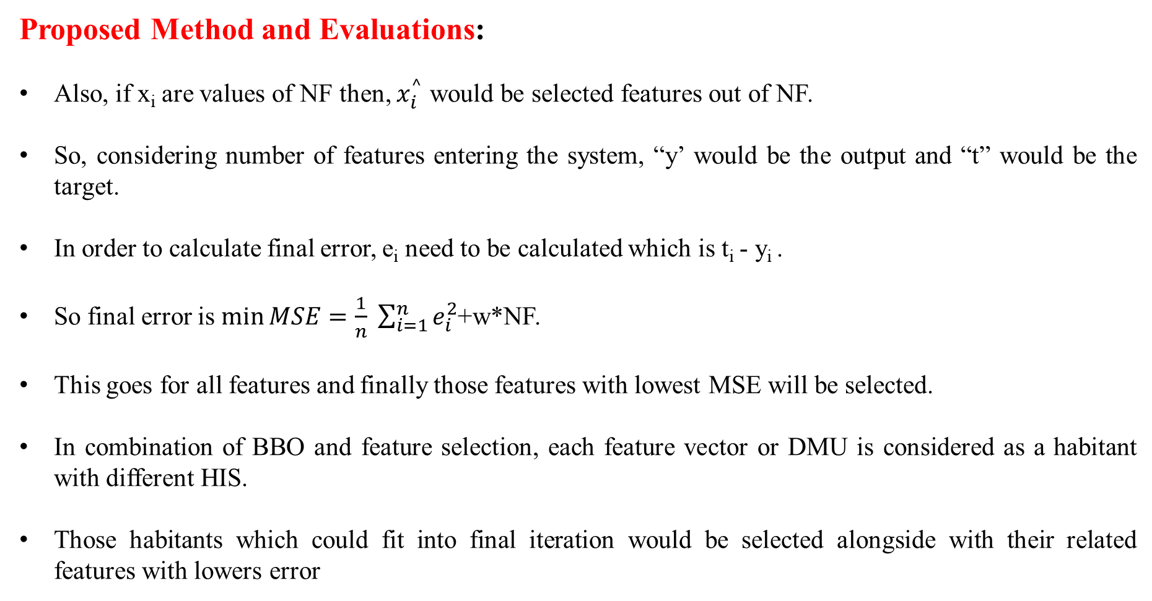
Proposed Method and Evaluations:
Also, if x_{i} are values of NF then, $x_{i}^{^}$ would be selected features out of NF.
So, considering number of features entering the system, “y’ would be the output and “t” would be the target.
In order to calculate final error, e_{i} need to be calculated which is t_{i} - y_{i} .
So final error is $\min{MSE=\frac{1}{n} \sum_{i=1}^{n}{e_{i}^{2}}}$+w*NF.
This goes for all features and finally those features with lowest MSE will be selected.
In combination of BBO and feature selection, each feature vector or DMU is considered as a habitant with different HIS.
Those habitants which could fit into final iteration would be selected alongside with their related features with lowers error
14
Nature-inspired DMU Selection and Evaluation in Data Envelopment Analysis

Slide 15
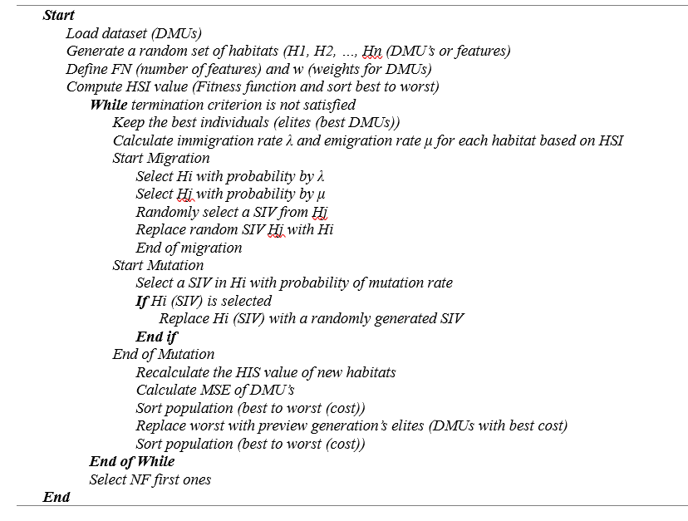
15
Nature-inspired DMU Selection and Evaluation in Data Envelopment Analysis

Slide 16
Proposed Method and Evaluations:
Data Envelopment Analysis (DEA)
Originally introduced by Charnas and Cooper in 1978 based on Farrell ideal in 1957.
DEA faces multiple forms of it by different researchers around the world.
But, still one of the most flexible tools in various areas specifically in management.
DEA employs to evaluate the performance of different kinds of entities in various range of activities and applications.
DEA main target is to estimate the system’s efficiency by different input and output factors which leads to select best DMU’s for having the most efficient system.
16
Nature-inspired DMU Selection and Evaluation in Data Envelopment Analysis

Slide 17
Proposed Method and Evaluations:
Data Envelopment Analysis (DEA)
Evaluates takes place with four common DEA methods of:
Charles Cooper and Rhodes (CCR)
Input-Oriented Banker, Chames and Cooper (IOBCC)
Output-Oriented BCC (OOBCC)
Additive efficiently
CCR model measures the Overall Technical Efficiency (OTE)
BCC model assesses the Pure Technical Efficiency (PTE)
CCR model has a straight-line efficiency frontier
BCC model has a convex line efficiency frontier
17
Nature-inspired DMU Selection and Evaluation in Data Envelopment Analysis

Slide 18
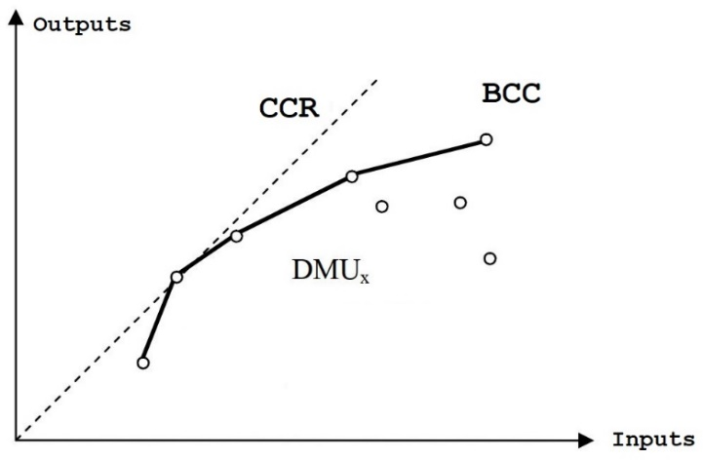
Proposed Method and Evaluations:
Data Envelopment Analysis (DEA)
18
Nature-inspired DMU Selection and Evaluation in Data Envelopment Analysis

Slide 19
Proposed Method and Evaluations:
Fuzzy Firefly Regression
Firefly Algorithm (FA) is one the most robust and famous nature-inspired optimizations algorithms.
It has proper application in learning for regression task.
Now, this regression could be aided with other clustering techniques as input data.
Here, Fuzzy C-Means clustering (FCM) is used.
Fuzzy C-means clustering is fuzzy model of K-means or Lloyd’s clustering algorithm.
By clustering the data in the initial step, data will be organized in an optimized manner for training step.
Clearly, more clusters, means more accuracy but brings more computational time too.
19
Nature-inspired DMU Selection and Evaluation in Data Envelopment Analysis

Slide 20
Proposed Method and Evaluations:
Fuzzy Firefly Regression
The goal here is to adjusting base fuzzy parameters according to modeling error by FA and returning best fuzzy parameters values as the final result.
So, initial fuzzy model creates by defining number of clusters.
FA is consisted of five main parts of:
Number of population (fireflies) or x
Light intensity of each firefly or I
Light absorption coefficient or γ (gamma)
Attraction coefficient or β and mutation rate.
It simply works as moving lower light intensity fireflies toward higher ones, effecting mutation and updating old and new solutions.
20
Nature-inspired DMU Selection and Evaluation in Data Envelopment Analysis

Slide 21
Proposed Method and Evaluations:
Fuzzy Firefly Regression
Basic FCM model will be transformed to a better fuzzy model after taking effect by FA on its membership functions and parameters.
By evaluating fuzzy FA model using fuzzy inference engine, final trained data (train and test) is available.
In order to calculate error fuzzy data should return to its original crisp mode which this action is called defuzzification.
Clearly, inputs are train and test inputs; and evaluated version of them are train and test outputs.
The difference between train, test outputs and train, test targets, provide system error which here are MSE, RMSE, Mean Error and STD Error.
21
Nature-inspired DMU Selection and Evaluation in Data Envelopment Analysis

Slide 22
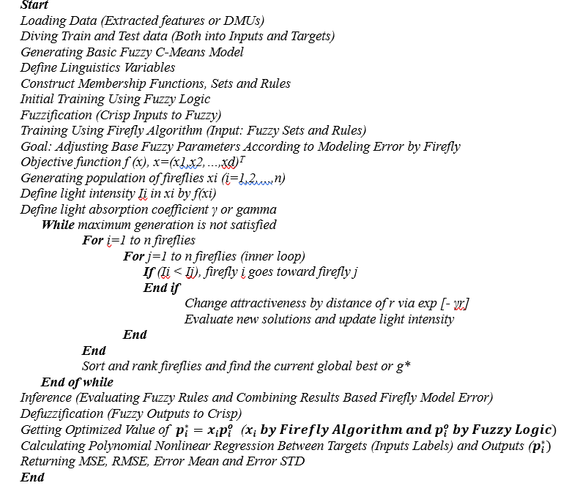
22
Nature-inspired DMU Selection and Evaluation in Data Envelopment Analysis

Slide 23
Proposed Method and Evaluations:
Nature-Inspired Algorithms’ Parameters
- | BBO Algorithm | Firefly Algorithm
Iteration | 1000 | 1000
Population | 20 Habitats | 15 Fireflies
Human Suitability Index (HIS) | Objective Function | *
Light Intensity of I | * | Objective Function
Variables | 10 | 10
Lower Bound (var min) | -10 | -10
Upper Bound (var max) | 10 | 10
Keep Rate | 0.2 | *
No of Kept Habitats | Keep Rate * Habitats | *
No of New Habitats | Habitats – Kept Habitats | *
Emigration Rate | μ = 0.2 | *
Immigration Rate | λ = 0.3 | *
Alpha | α = 0.9 | α = 0.2 (mutation coefficient)
Mutation Probability | 0.1 | *
Sigma | ς = 0.02*(var max -var min) | *
Light Absorption Coefficient | * | γ = 0.1
Attraction Coefficient | * | β = 2
Delta (Mutation Range) | * | δ = 0.05*(var max-var min)
23
Nature-inspired DMU Selection and Evaluation in Data Envelopment Analysis

Slide 24
Proposed Method and Evaluations:
Experiment’s Datasets
Name | Area | Associated Task (s) | Instances | Features
Clickstream Data for Online Shopping | Business | Classification, Regression, Clustering | 165474 | 14
Daily Demand Forecasting Orders | Business | Regression | 60 | 13
Online News Popularity | Business | Classification, Regression | 39797 | 61
Statlog (Australian Credit Approval) | Financial | Classification, Regression | 690 | 14
24
Nature-inspired DMU Selection and Evaluation in Data Envelopment Analysis

Slide 25
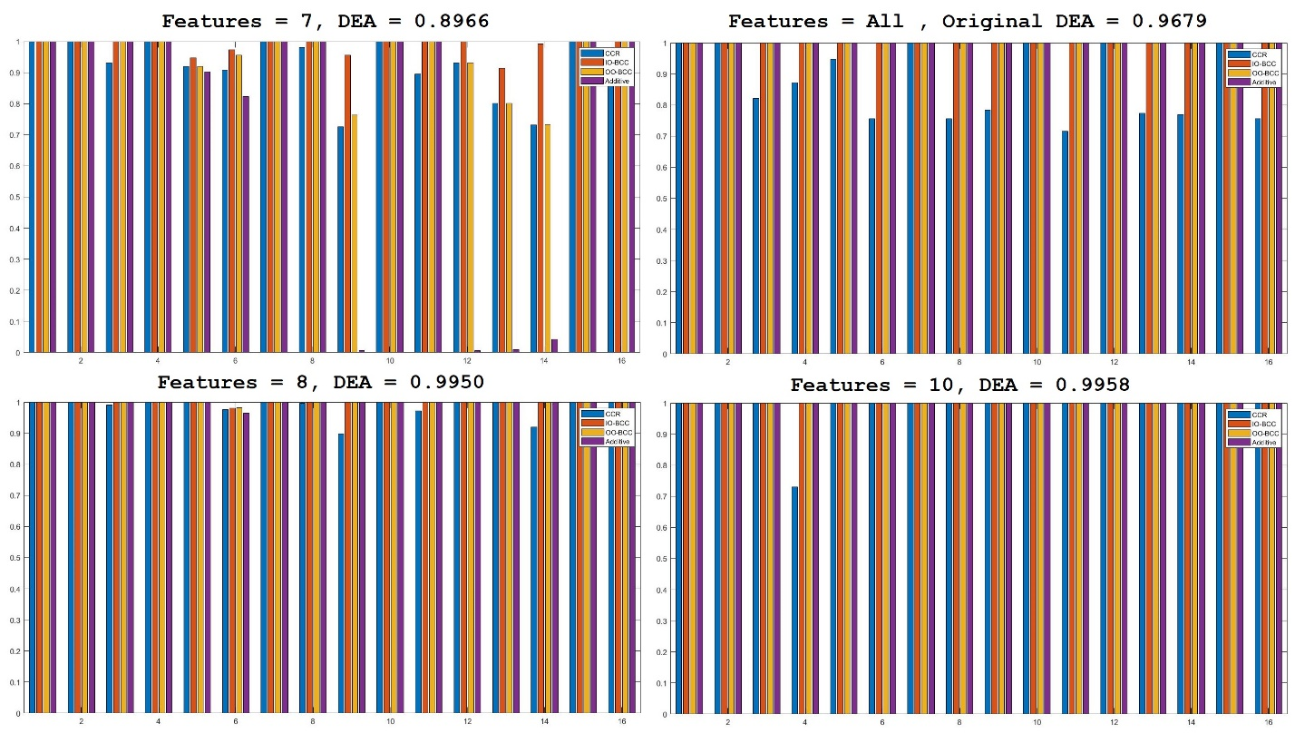
Testing bar plot of BBO feature selection on samples of daily demand forecasting order dataset versus DEA on original data
25
Nature-inspired DMU Selection and Evaluation in Data Envelopment Analysis

Slide 26
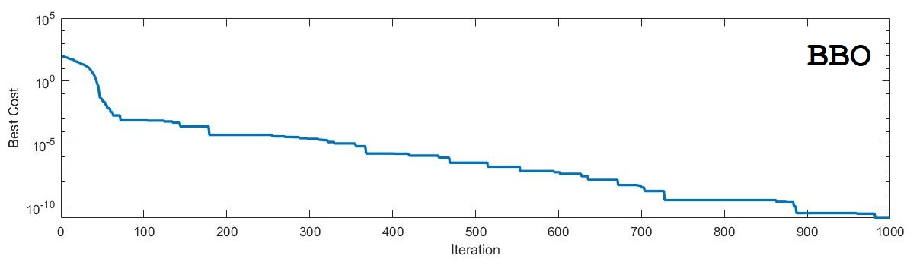
BBO algorithm training stage for feature selection over 1000 iterations
26
Nature-inspired DMU Selection and Evaluation in Data Envelopment Analysis

Slide 27
Features = DMUs | Clickstream | Daily Demand | Online News | Statlog
Original DEA (all features) | 0.837 | 0.926 | 0.844 | 0.883
Lasso DEA
Rank 1 = 75 % of Features | 0.691 | 0.839 | 0.799 | 0.817
Rank 2 = 50 % of Features | 0.601 | 0.782 | 0.749 | 0.781
Rank 3 = 25 % of Features | 0.588 | 0.754 | 0.694 | 0.758
GA Features DEA
Rank 1 = 75 % of Features | 0.825 | 0.937 | 0.905 | 0.899
Rank 2 = 50 % of Features | 0.799 | 0.879 | 0.866 | 0.857
Rank 3 = 25 % of Features | 0.767 | 0.867 | 0.805 | 0.796
PSO Features DEA
Rank 1 =75 % of Features | 0.812 | 0.951 | 0.857 | 1.000
Rank 2 = 50 % of Features | 0.786 | 0.928 | 0.817 | 0.881
Rank 3 = 25 % of Features | 0.772 | 0.876 | 0.800 | 0.856
BBO Features DEA
Rank 1 = 75 % of Features | 0.919 | 1.000 | 0.961 | 1.000
Rank 2 = 50 % of Features | 0.884 | 0.969 | 0.863 | 0.957
Rank 3 = 25 % of Features | 0.803 | 0.900 | 0.840 | 0.883
Average of CCR, IOBCC, OOBCC and Additive methods on datasets and comparison with other methods in three ranks
27
Nature-inspired DMU Selection and Evaluation in Data Envelopment Analysis

Slide 28
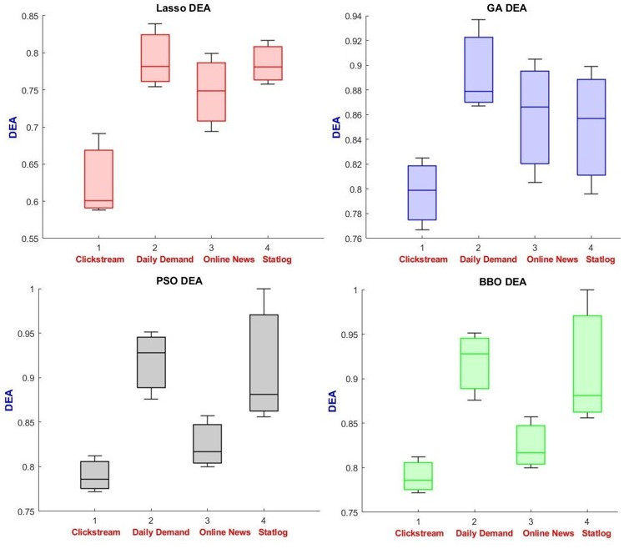
Comparison of different methods as box plots
28
Nature-inspired DMU Selection and Evaluation in Data Envelopment Analysis

Slide 29
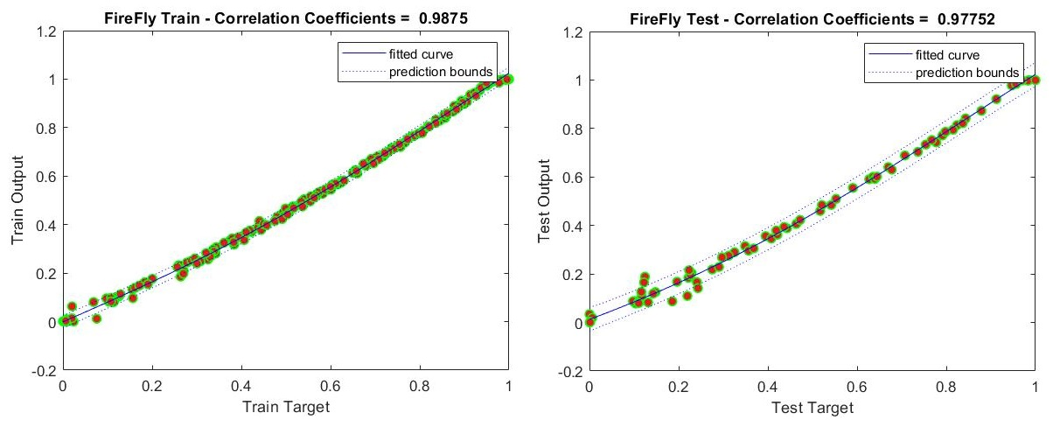
Fuzzy Firefly non-linear regression test on samples of online news popularity dataset after BBO feature selection by 25 % of DMUs
29
Nature-inspired DMU Selection and Evaluation in Data Envelopment Analysis

Slide 30
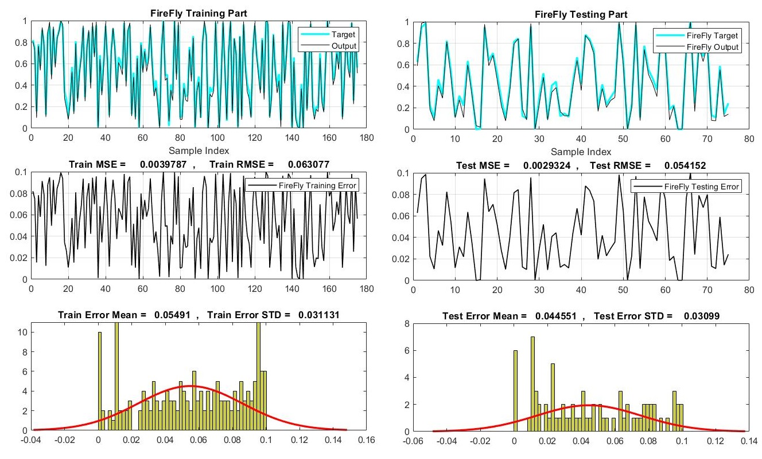
MSE, RMSE, Error Mean, Error STD for regression experiment of online news popularity dataset
30
Nature-inspired DMU Selection and Evaluation in Data Envelopment Analysis

Slide 31
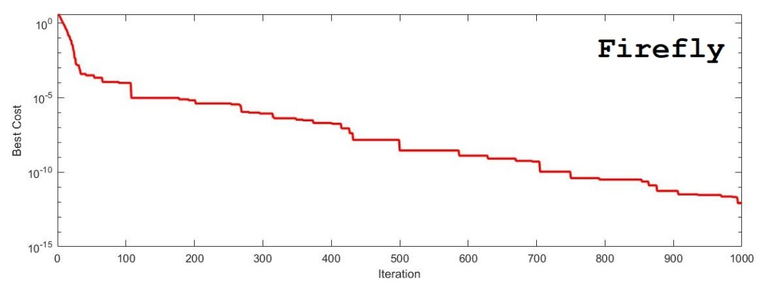
Firefly algorithm training for regression stage over 1000 iterations
31
Nature-inspired DMU Selection and Evaluation in Data Envelopment Analysis

Slide 32
Proposed Method and Evaluations:
Features = DMUs | Clickstream | Daily Demand | Online News | Statlog
Fuzzy Regression
Rank 1 = 75 % of Features | CC = 0.836 MSE = 0.285 | CC = 0.882 MSE = 0.154 | CC = 0.944 MSE = 0.081 | CC = 0.970 MSE = 0.022
Rank 2 = 50 % of Features | CC = 0.779 MSE = 0.300 | CC = 0.875 MSE = 0.181 | CC = 0.937 MSE = 0.099 | CC = 0.969 MSE = 0.082
Rank 3 = 25 % of Features | CC = 0.783 MSE = 0.319 | CC = 0.850 MSE = 0.187 | CC = 0.912 MSE =0.058 | CC = 0.920 MSE = 0.061
Fuzzy Firefly Regression
Rank 1 = 75 % of Features | CC = 0.936 MSE = 0.211 | CC = 0.928 MSE = 0.119 | CC = 0.991 MSE = 0.004 | CC = 0.998 MSE = 0.001
Rank 2 = 50 % of Features | CC = 0.889 MSE = 0.260 | CC = 0.905 MSE = 0.117 | CC = 0.980 MSE = 0.059 | CC = 0.983 MSE = 0.036
Rank 3 = 25 % of Features | CC = 0.849 MSE = 0.297 | CC = 0.900 MSE = 0.162 | CC = 0.987 MSE = 0.032 | CC = 0.996 MSE = 0.007
CC and MSE comparison for fuzzy regression and fuzzy firefly regression in three ranks of features on four datasets
32
Nature-inspired DMU Selection and Evaluation in Data Envelopment Analysis

Slide 33
Proposed Method and Evaluations:
By looking at the results, performance of the Lasso regularizations DEA meets the modest.
However, original DEA on all data have achieved medium performance.
GA DEA shows a little bit better performance than original DEA in all ranks.
Second places go to PSO DEA and best results belongs to BBO DEA.
Average value of 0.914 is returned for all ranks and all datasets and for all DEA methods after the proposed feature selection method.
Additionally, average correlation coefficient of 0.945 and average MSE of 0.132 are returned by fuzzy firefly regression method for all datasets and ranks which is significant.
33
Nature-inspired DMU Selection and Evaluation in Data Envelopment Analysis

Slide 34
Conclusion:
By empowering DEA with nature-inspired algorithms, it is possible to achieve more efficient results compare to using traditional DEA.
Nature-inspired feature selection (here BBO) could remove more inefficient DMUs rather than mathematical PCA or Lasso algorithms which are not intelligent.
Furthermore, to have better understanding of relation between variables after DMU selection, a nature-inspired regression (here Firefly) in combination with fuzzy logic which could provide higher correlation coefficient versus old techniques, is used.
Overall, by employing mentioned techniques, more efficient and precise result returned in comparison with other methods.
However, due to using optimization algorithm, runtime is sacrificed.
34
Nature-inspired DMU Selection and Evaluation in Data Envelopment Analysis

Slide 35
Conclusion:
Using more related business and management datasets plus comparing the propose system with deep learned feature selection and regression methods is of future works.
For this research the system had 7 cores of CPU, so it is suggested to run the proposed system on over 5000 iterations and more than 50 populations, as optimization algorithms demand more hardware resource.
The proposed system could be used as a decent tool for resource allocation in business and management applications, when number of DMUs are so high.
35
Nature-inspired DMU Selection and Evaluation in Data Envelopment Analysis

Slide 36
References:
1. Charles, Vincent, and Mukesh Kumar, eds. Data envelopment analysis and its applications to management. Cambridge Scholars Publishing, 2013.
2. Mousavi, Seyed Muhammad Hossein, Vincent Charles, and Tatiana Gherman. "An evolutionary Pentagon Support Vector finder method." Expert Systems with Applications 150 (2020): 113284.
3. Ghosh, Manosij, et al. "Binary genetic swarm optimization: A combination of GA and PSO for feature selection." Journal of Intelligent Systems 29.1 (2020): 1598-1610.
4. Simon, Dan. "Biogeography-based optimization." IEEE transactions on evolutionary computation 12.6 (2008): 702-713.
5. Mousavi, Seyed Muhammad Hossein, S. Younes MiriNezhad, and Atiye Mirmoini. "A new support vector finder method, based on triangular calculations and K-means clustering." 2017 9th International Conference on Information and Knowledge Technology (IKT). IEEE, 2017.
6. Charles, Vincent, and Tatiana Gherman. "Big data analytics and ethnography: Together for the greater good." Big data for the greater good. Springer, Cham, 2019. 19-33.
7. Abdi, Hervé, and Lynne J. Williams. "Principal component analysis." Wiley interdisciplinary reviews: computational statistics 2.4 (2010): 433-459.
8. Tibshirani, Robert. "Regression shrinkage and selection via the lasso." Journal of the Royal Statistical Society: Series B (Methodological) 58.1 (1996): 267-288.
9. Zhang, Yishi, et al. "Feature selection using data envelopment analysis." Knowledge-Based Systems 64 (2014): 70-80.
10. "Feature selection using PSO-SVM." International Journal of Computer Science (2007).
11. Babatunde, Oluleye H., et al. "A genetic algorithm-based feature selection." (2014).
12. Yang, Xin-She. Nature-inspired metaheuristic algorithms. Luniver press, 2010.
13. Charnes, Abraham, William W. Cooper, and Edwardo Rhodes. "Measuring the efficiency of decision making units." European journal of operational research 2.6 (1978): 429-444.
36
Nature-inspired DMU Selection and Evaluation in Data Envelopment Analysis

Slide 37
References:
14. Farrell, Michael James. "The measurement of productive efficiency." Journal of the Royal Statistical Society: Series A (General) 120.3 (1957): 253-281.
15. Zadeh, Lotfi A. "Fuzzy logic." Computer 21.4 (1988): 83-93.
16. Bezdek, James C., Robert Ehrlich, and William Full. "FCM: The fuzzy c-means clustering algorithm." Computers & geosciences 10.2-3 (1984): 191-203.
17. Likas, Aristidis, Nikos Vlassis, and Jakob J. Verbeek. "The global k-means clustering algorithm." Pattern recognition 36.2 (2003): 451-461.
18. Łapczyński, Mariusz, and Sylwester Białowąs. "Discovering Patterns of Users' Behaviour in an E-shop-Comparison of Consumer Buying Behaviours in Poland and Other European Countries." Studia Ekonomiczne 151 (2013): 144-153.
19. Ferreira, R. Pinto, et al. "Study on daily demand forecasting orders using artificial neural network." IEEE Latin America Transactions 14.3 (2016): 1519-1525.
20. Fernandes, Kelwin, Pedro Vinagre, and Paulo Cortez. "A proactive intelligent decision support system for predicting the popularity of online news." Portuguese conference on artificial intelligence. Springer, Cham, 2015.
21. Quinlan, J. Ross. "Simplifying decision trees." International journal of man-machine studies 27.3 (1987): 221-234.
22. Zuo, Hua, et al. "Fuzzy regression transfer learning in Takagi–Sugeno fuzzy models." IEEE Transactions on Fuzzy Systems 25.6 (2016): 1795-1807.
23. Murphy, Allan H. "Skill scores based on the mean square error and their relationships to the correlation coefficient." Monthly weather review 116.12 (1988): 2417-2424.
24. Javed, A. (2013). Face recognition based on principal component analysis. International Journal of Image, Graphics and Signal Processing, 5(2), 38.
25. Singh, Y., & Tiwari, M. (2022). A Novel Hybrid Approach for Detection of Type-2 Diabetes in Women Using Lasso Regression and Artificial Neural Network.
26. Singh, A., Singh, P. I., & Kaur, P. (2012). Digital Image Enhancement with Fuzzy Interface System. International Journal of Information Technology and Computer Science (IJITCS), 51.
37
Nature-inspired DMU Selection and Evaluation in Data Envelopment Analysis

Slide 38
Thank You So Much for Your Attention
?
38
Nature-inspired DMU Selection and Evaluation in Data Envelopment Analysis

